Slide 1

JIRA

Slide 2
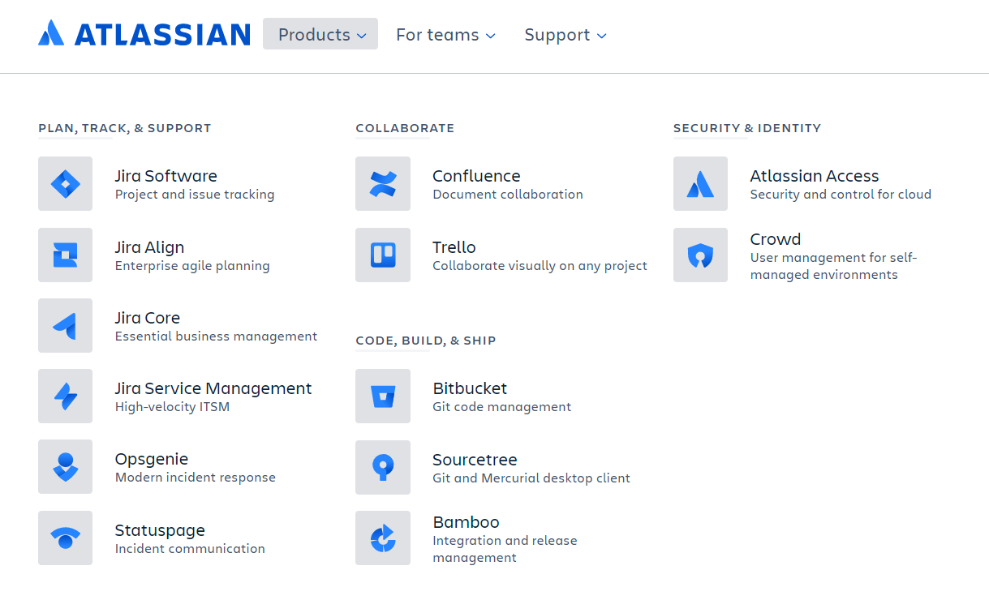

Slide 3
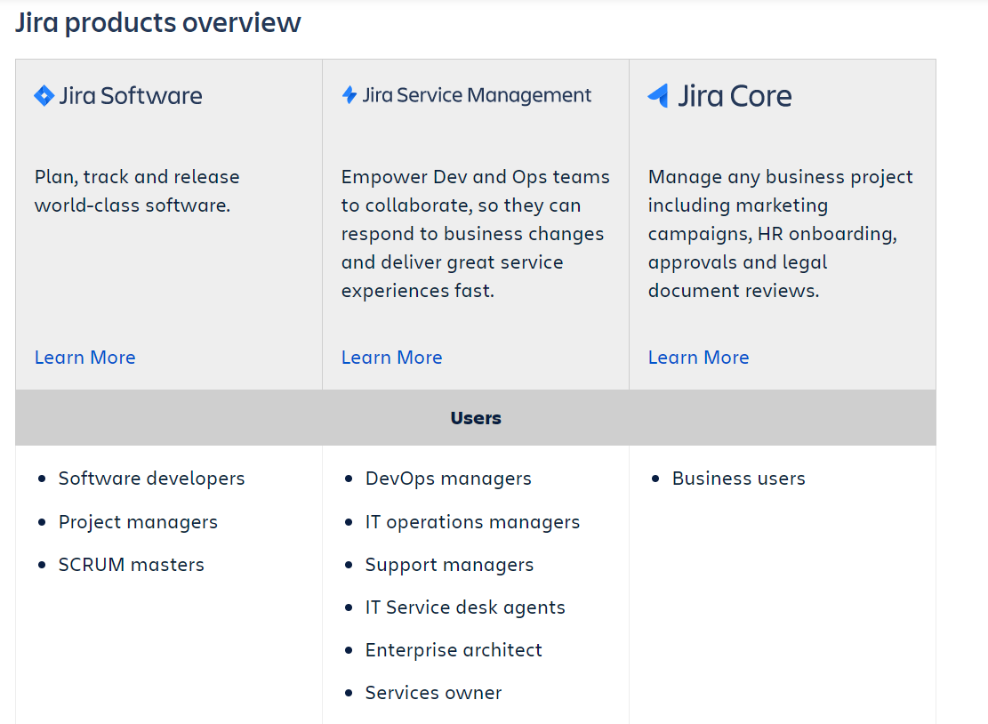
Overview of Jira Platform
Jira is a family of products built to help all types of teams manage their work. Jira offers several products and deployment options that are purpose-built for Software, IT, Business, Ops teams, and more.
Products and apps built on top of the Jira platform help teams plan, assign, track, report and manage work.
.

Slide 4
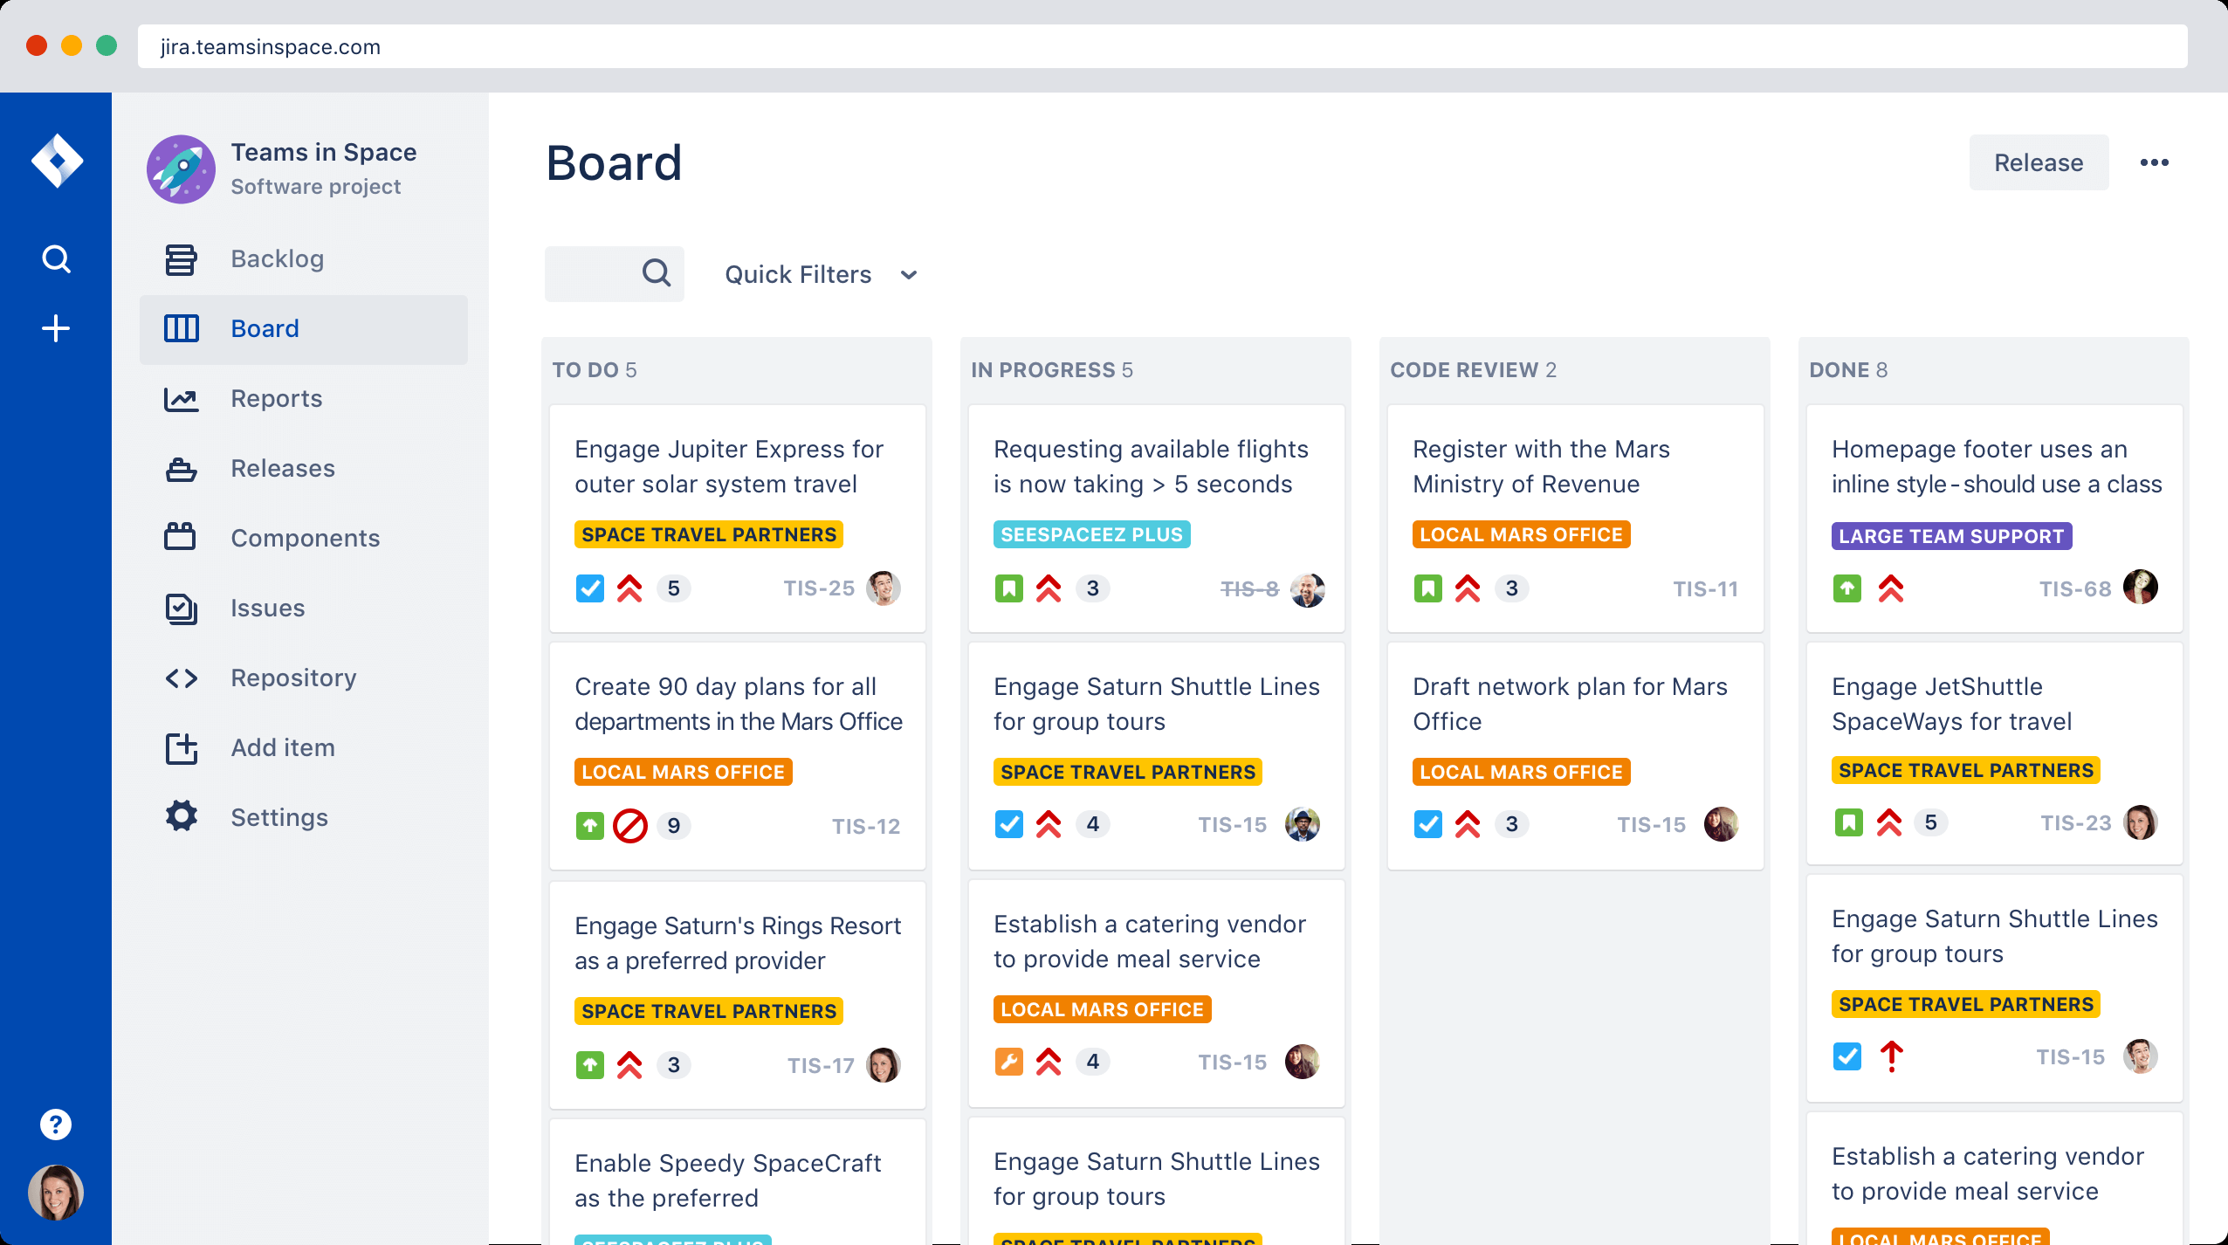
Overview of Jira Software
Jira Software is built for every member of your software team to plan,track, and release great software.

Slide 5
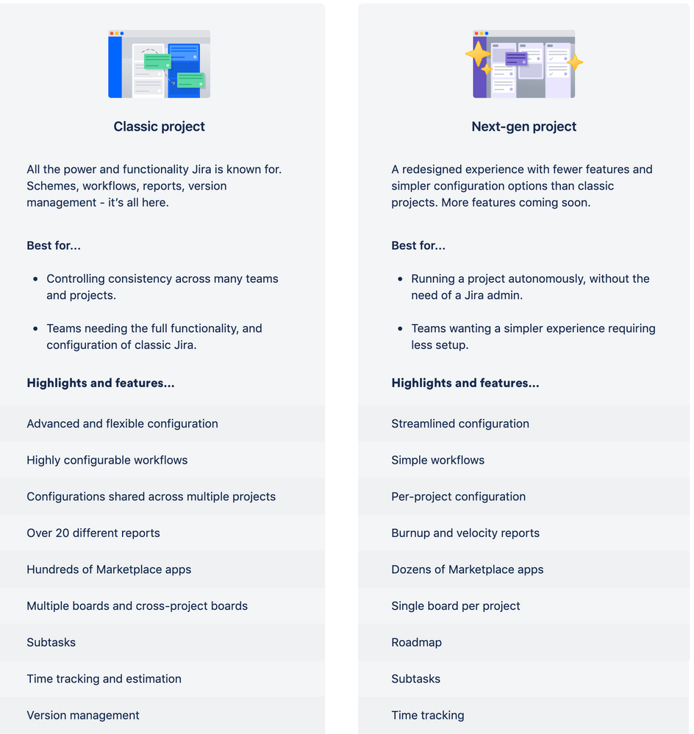
Jira Classic vs NextGen

Slide 6
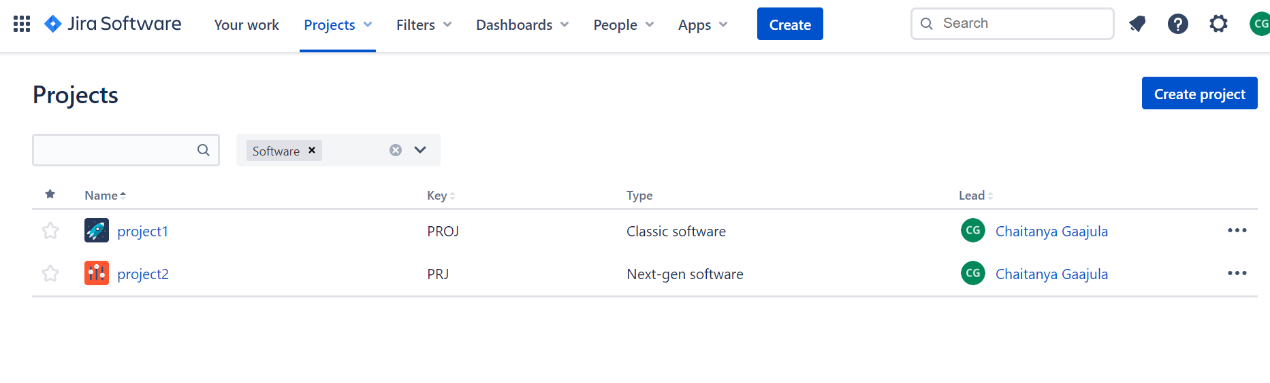
Using & Navigating Jira Software

Slide 7
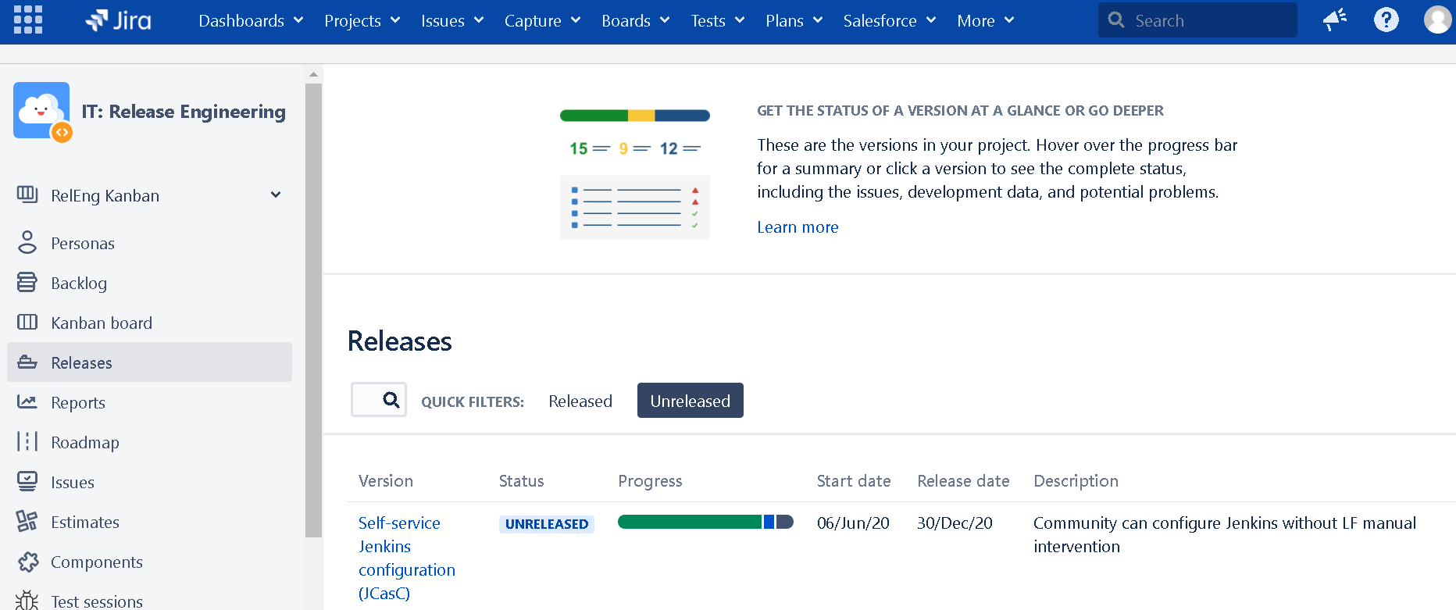
Working with Jira Projects
A Jira project is a collection of issues. Teams could use a Jira project to coordinate the development of a product, track a project, manage a help desk, and more, depending on your requirements. A Jira project can also be configured and customized to suit the needs for yourself and your team

Slide 8
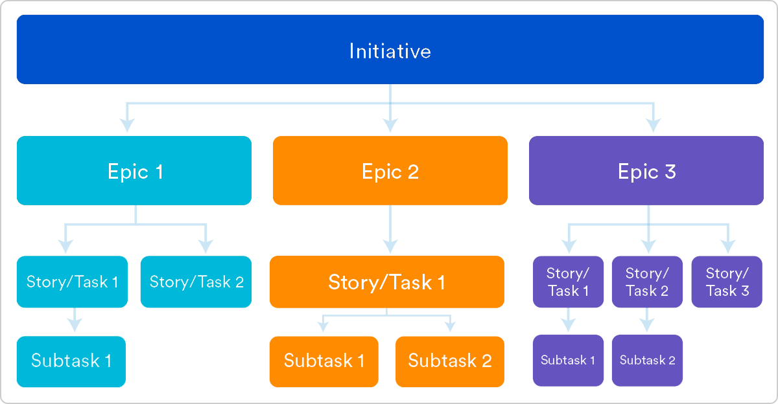
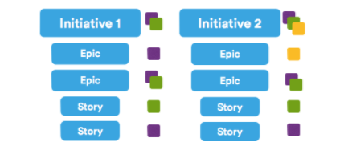
User Stories , Epics and Initiatives
Stories, also called “user stories,” are short requirements or requests written from the perspective of an end user.
Epics are large bodies of work that can be broken down into a number of smaller tasks (called stories).
Initiatives are collections of epics that drive toward a common goal.

Slide 9
What are User Stories ?
User stories in Jira are concise representations of a feature in a developing system described by an individual who needs this new functionality.
It must be informative enough to allow the Jira developer/development team to facilitate analyzing, designing, and creating the specified functionality, feature, or requirement.
In an Agile project, these stories are primary methods for communicating developer or development team requirements.
It is essential that the person charged with recording the specifications can write sufficiently comprehensive and successful user stories.
Many teams post stories to the Scrum board and determine which stories and related specifications will be added to the backlog during the sprint planning meeting.

Slide 10
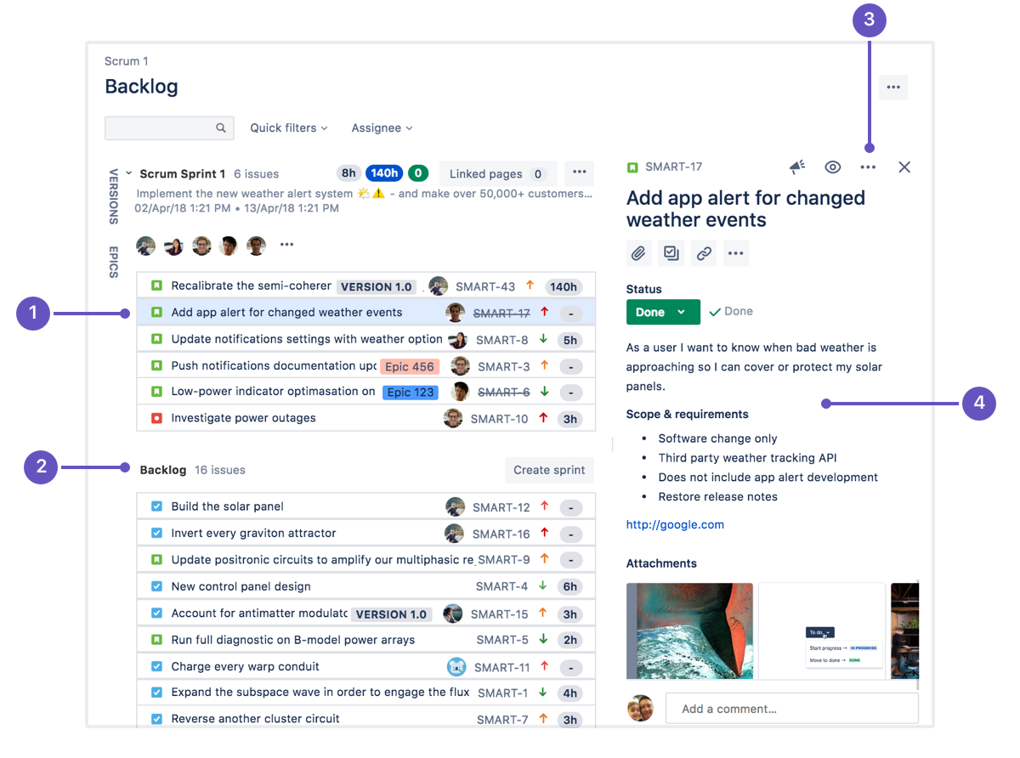
Working with Issues
Different organizations use Jira to track different kinds of issues, which can represent anything from a software bug, to a project task, or a leave request form.
Issues are the building blocks of any Jira project. An issue could represent a story, a bug, a task, or another issue type in your project.

Slide 11
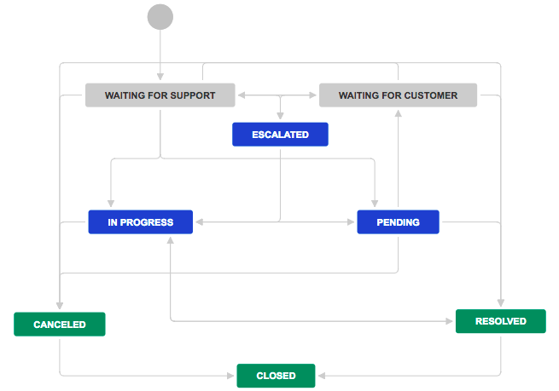
Work with issue workflows
A Jira workflow is a set of statuses and transitions that an issue moves through during its lifecycle, and typically represents a process within your organization. Workflows can be associated with particular projects and, optionally, specific issue types by using a workflow scheme.
Jira has built-in workflows that you can use without needing to make any changes, or you can start fresh and create your own. You can't edit the built-in workflows, but you can copy them and use the copy as a basis to create your own.

Slide 12
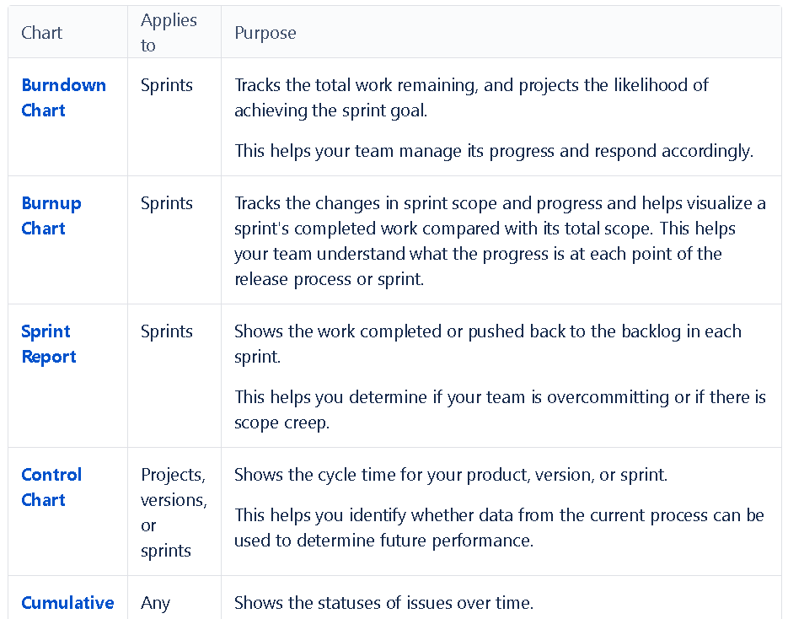
Overview of Jira Reports & Using Reports Features
Reporting is an activity that you will be doing throughout a project. Jira Software has a range of reports that you can use to show information about your project, versions, epics, sprints, and issues.

Slide 13
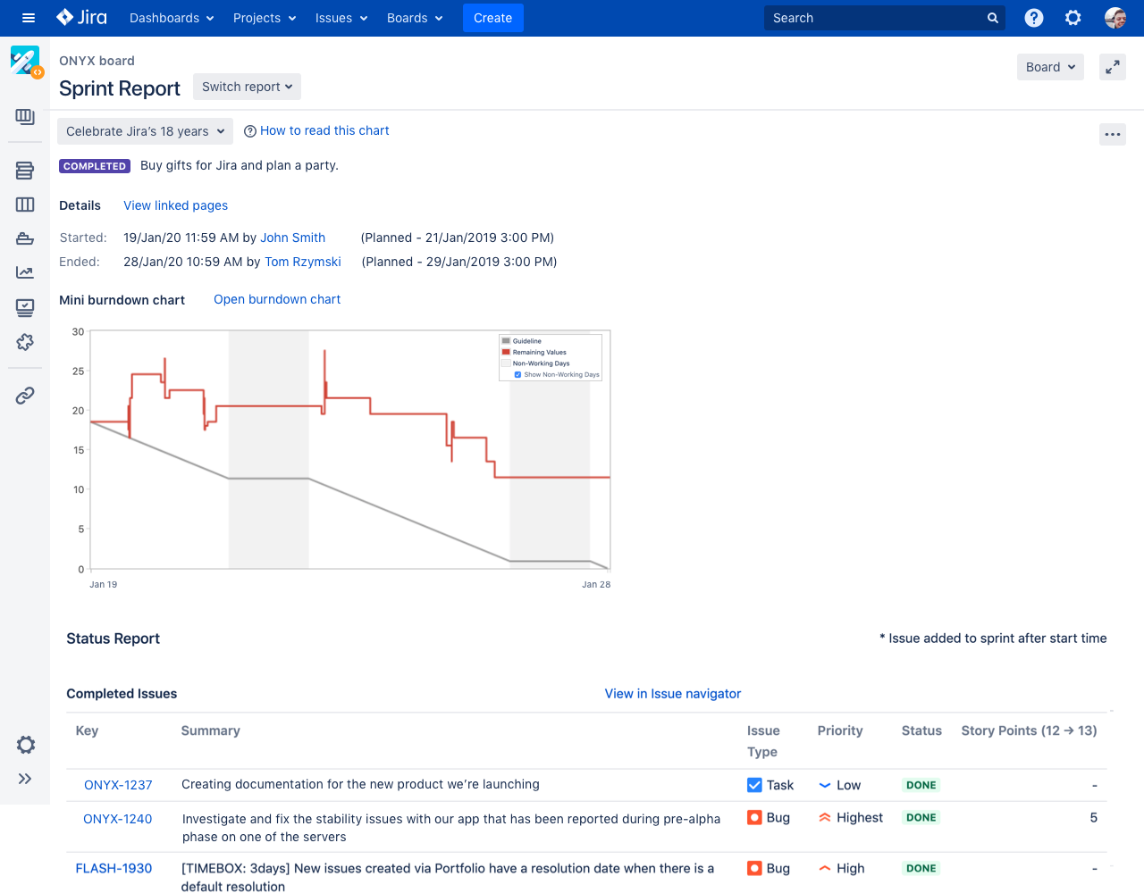
Spring Report
The Sprint Report shows the list of issues in each sprint. It is useful for your Sprint Retrospective meetings, and also for mid-sprint progress checks.

Slide 14
Reference Links
https://www.atlassian.com/software/jira/guides/getting-started/overview
https://www.atlassian.com/software/jira
https://support.atlassian.com/jira-software-cloud/docs/what-is-a-jira-software-project/
https://support.atlassian.com/jira-software-cloud/docs/what-is-an-issue/
https://support.atlassian.com/jira-cloud-administration/docs/work-with-issue-workflows/
https://confluence.atlassian.com/jirasoftwareserver/reporting-939938675.html#:~:text=Reporting%20is%20an%20activity%20that,the%20reports%20in%20Jira%20Software.
https://www.atlassian.com/software/jira/guides/getting-started/best-practices#jira-project-best-practices

Slide 15


